Slide 1
Fuel Economy Optimization
Natalie Dela Cruz

Slide 2
Overall Objectives
01
02
03
04
Goal
Data
What factors drive fuel economy and annual fuel costs?
Evaluate the overall analyzed data
Hypotheses
Recommendations
Hypotheses tests & overviews
Provide recommended actions based on the analysis

Slide 3
Data Analyzed
Year
Car Make
Manufactured between 1984 and 2017
133 car makes
Avg Annual Fuel Cost
Sample Size
38113 samples are taken
$2,054

Slide 4
Hypotheses Overview
H₁
There is (no) statistically significant difference in the mean of annual fuel cost between automatic and manual car
There is (no) statistically significant difference in
the mean of annual fuel cost between electric fuel and regular gas fuel
H₂
There is (no) statistically significant difference in
the mean of annual fuel cost between car with
and without start/stop technology
H₃
There is (no) statistically significant difference in the mean of annual fuel cost between electric/hybrid and non-hybrid car
H₄

Slide 5
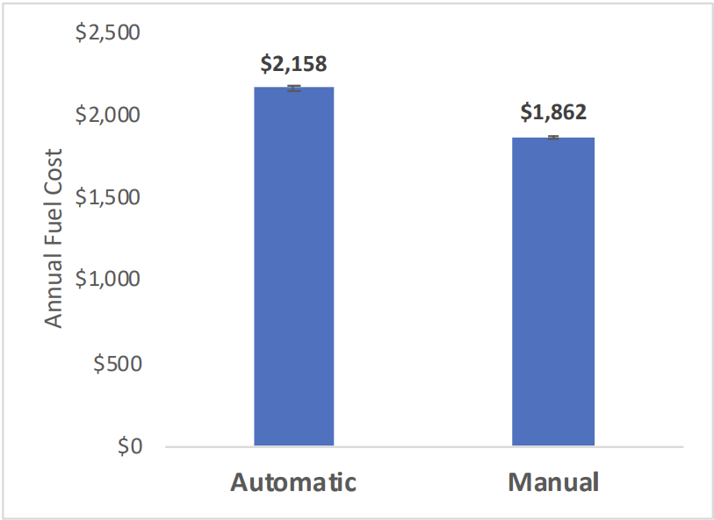
Automatic vs Manual
Ho: Transmission type has no effect on annual fuel cost
Ha: Transmission type does have an effect on annual fuel cost
Statistically significant difference between automatic
and manual car
(Therefore, reject null hypothesis)
⇢ With 95% confidence, the annual fuel cost for manual
car is between $282 and $309 less compared to
automatic car

Slide 6
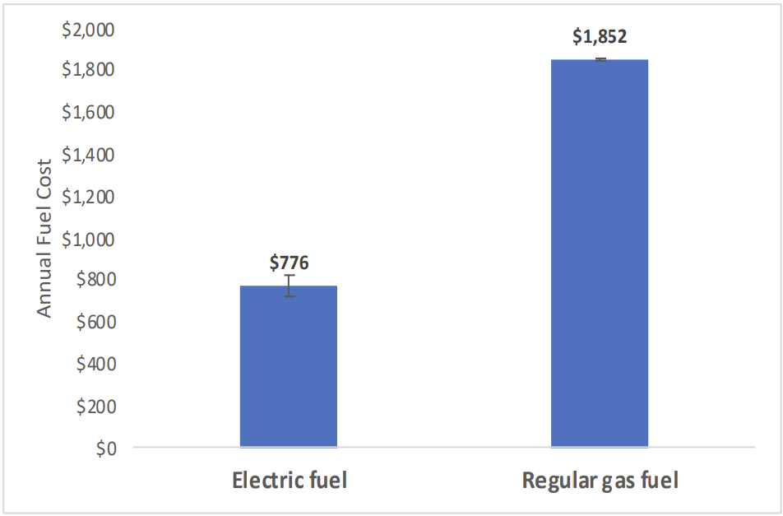
Electric Fuel vs Regular Gas
Ho: Fuel type has no effect on annual fuel cost
Ha: Fuel type does have an effect on annual fuel cost
Statistically significant difference between
electric fuel and regular gas
(Therefore, reject null hypothesis)
⇢ With 95% confidence, the annual fuel cost for car only uses electric fuel is between $1023 and $1128 less compared to car only uses regular gas

Slide 7
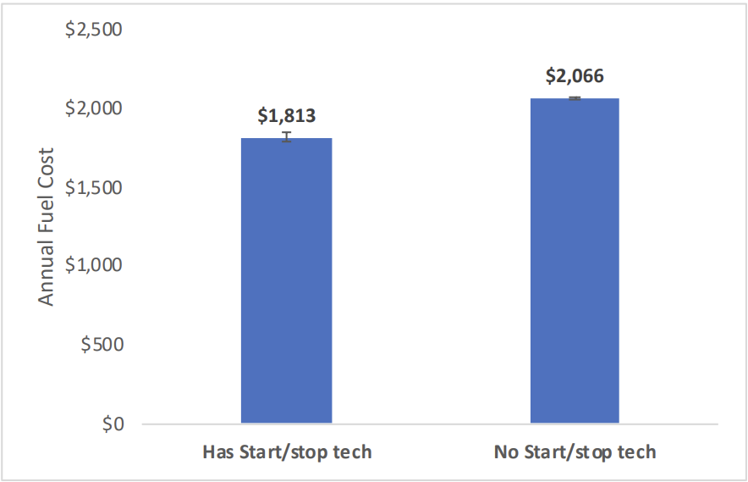
Start/Stop Technology
Ho: Start/Stop Technology has no effect on annual fuel cost
Ha: Start/Stop Technology does have an effect on annual
fuel cost
Statistically significant difference between car with and
without Start/Stop Technology
(Therefore, reject null hypothesis)
⇢ With 95% confidence, the annual fuel cost for car with
Start/Stop Technology is between $219 and $286 less
compared to car without it

Slide 8
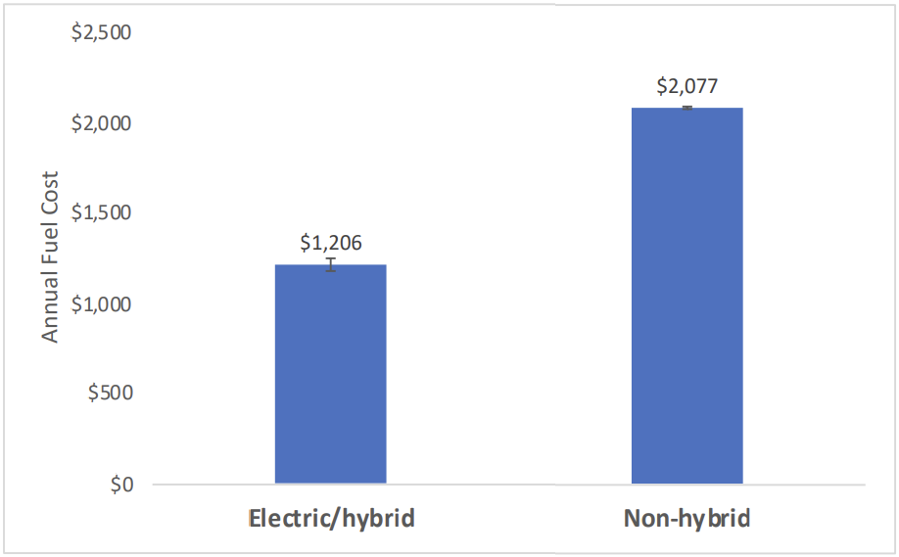
Electric/Hybrid vs. Non-Hybrid
Ho: Car power type has no effect on annual fuel cost
Ha: Car power type does have an effect on annual fuel cost
Statistically significant difference between electric/hybrid
and non-hybrid car
(Therefore, reject null hypothesis)
⇢ With 95% confidence, the annual fuel cost for electric
and hybrid car is between $832 and $908 less compared
to non-hybrid car

Slide 9
Top 3 Fuel Economy Car Class
1
Small SUV
Avg annual fuel cost: $1,525
Avg MPG: 24.3
2
Small Station Wagon
Avg annual fuel cost: $1,586
Avg MPG: 24.2
3
Compact Cars
Avg annual fuel cost: $1,680
Avg MPG: 23.4

Slide 10
Top 3 Alternative Fuel Vehicles
1
Electric Vehicle
Avg annual fuel cost: $776
Avg MPG: 93
2
Hybrid
Avg annual fuel cost: $1,277
Avg MPG: 32
3
Plug-In Hybrid
Avg annual fuel cost: $1,308
Avg MPG: 33

Slide 11
Recommendations
Manual Cars
Electric Fuel
Start/Stop Technology
About $300 less fuel
cost compared to
automatic car
About $1100 less fuel
cost compared to
regular gas
About $250 less fuel cost
compared to car without
start/stop feature
Electric/Hybrid
Small Car
Electric Car
About $900 less fuel
cost compared to non-hybrid car
Compact size car has less
fuel cost and better MPG
Electric car has overall
best performance

Slide 12
THANK YOU!
Do you have any questions?

